Slide 1

Lightning mechanisms

Slide 2
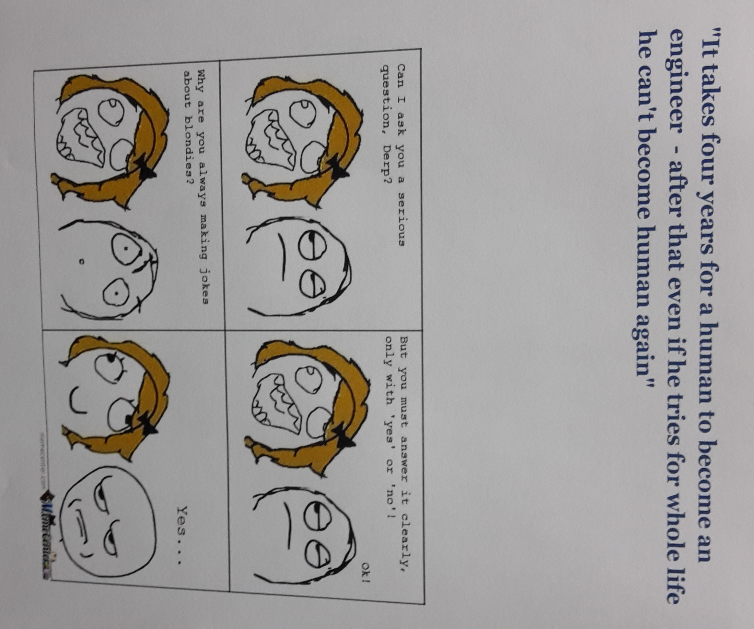

Slide 3
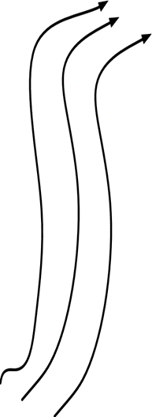

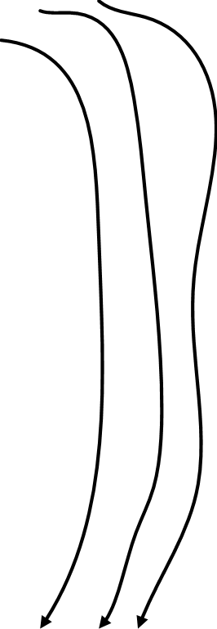

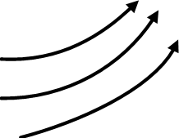

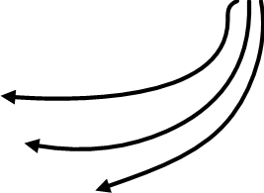

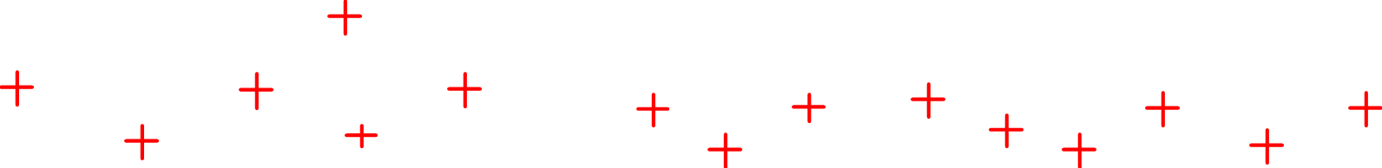
P
-51 C
Upward draft (warm air)
N
1.5 to 12 km
Downward draft (cold air)
0 C
P
17 C
Up to 1.5 km
Cold air dragged down by rain
Warm winds blowing towards the cloud
Rain (hydrometeos – water droplets & ice particles)
Up to 8 km

Slide 4

http://science.time.com/2013/06/24/bolts-from-the-blue-the-beauty-of-lightning/photo/lightning-statue-of-liberty/

Slide 5
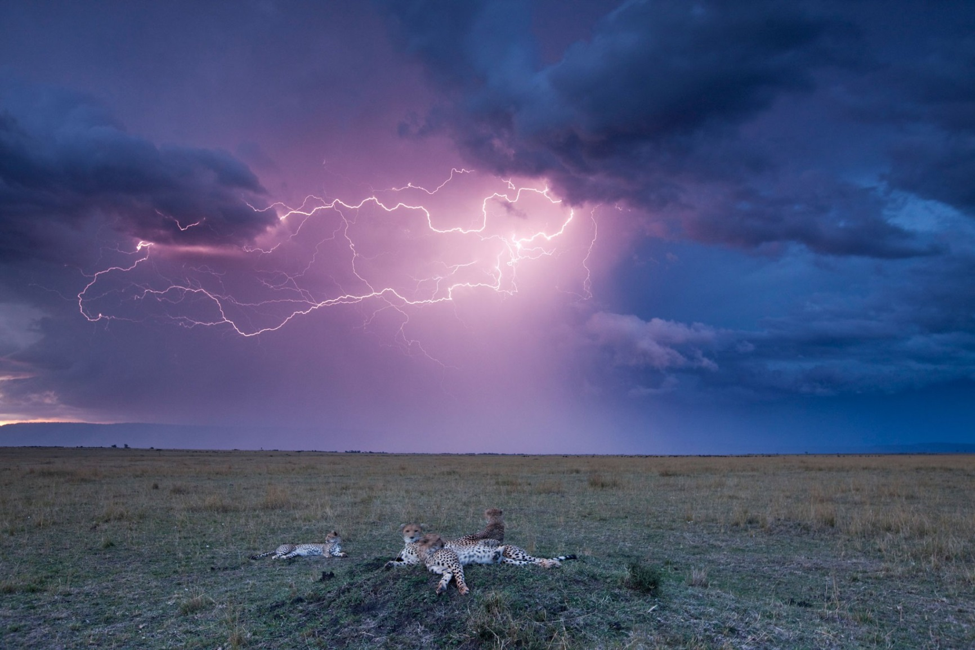

Slide 6
Summary of cloud – ground lightning mechanism
Thunder clouds carry cells of electrically charged particles (hydrometeors)
Electrical discharges (lightning flashes) can occur:
Within the cloud (intra-cloud lightning)
Between clouds (inter-cloud lightning)
Between cloud and ground (cloud-ground lightning)
Discharges are essentially streamer mechanisms

Slide 7
Lightning mechanisms summary continued
Cloud to ground lightning flash occurs in well defined and characteristic steps:
Downward stepped leader & upward positive streamers
Attachment
1st return stroke
Dart leader
2nd return stroke
Each flash can have multiple strokes
Lightning is a highly stochastic phenomena dependent on many variables
Much is known but much is still to be known and this gives room for myths and further research

Slide 8
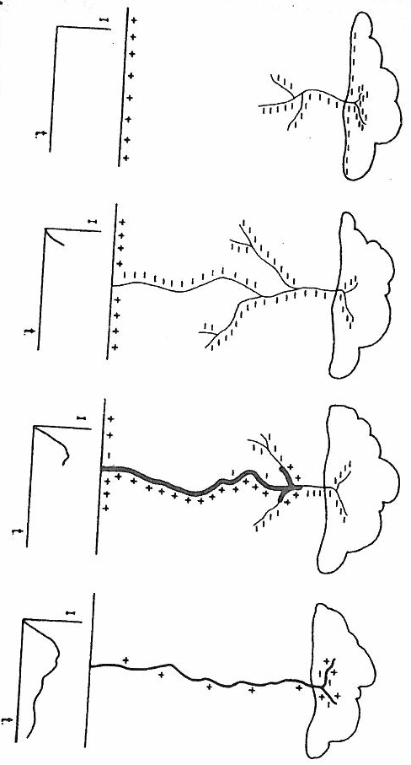

Slide 9
Lightning injury mechanisms
Direct strike
Minimise risk by avoiding open spaces or being tallest feature under lightning activity
2. Side flash
Avoid being in contact with any object during lightning activity
3. Touch/contact potential
Avoid being near any object (especially taller) during lightning activity
4. Step potential
Keep legs together and be in a crouched position during lightning
5. Positive streamers
Shelter in lightning protected structures

Slide 10
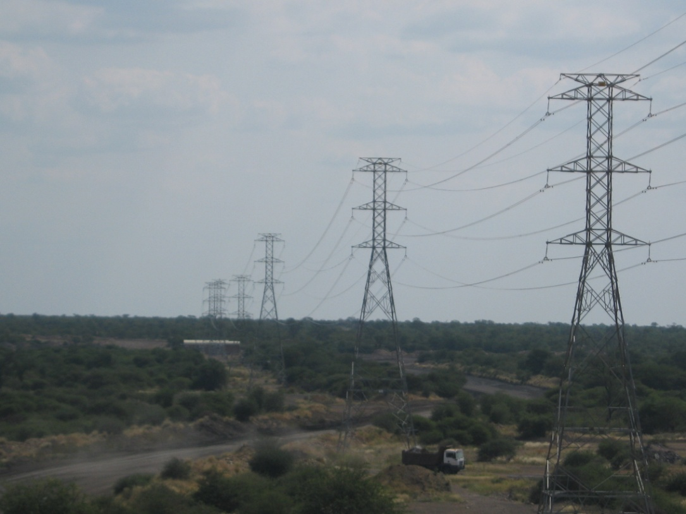

Slide 11
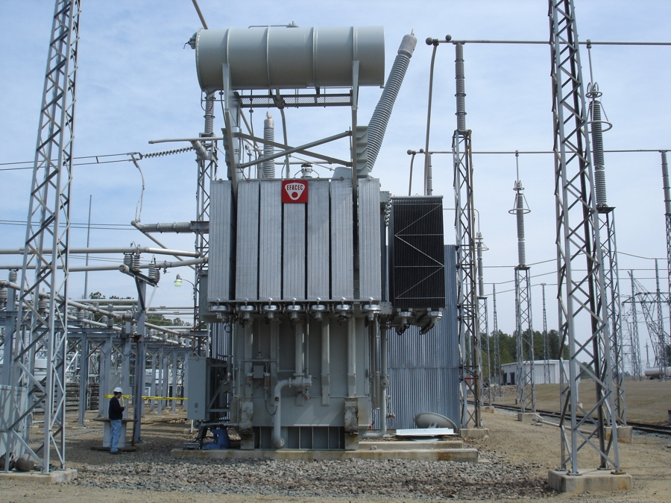
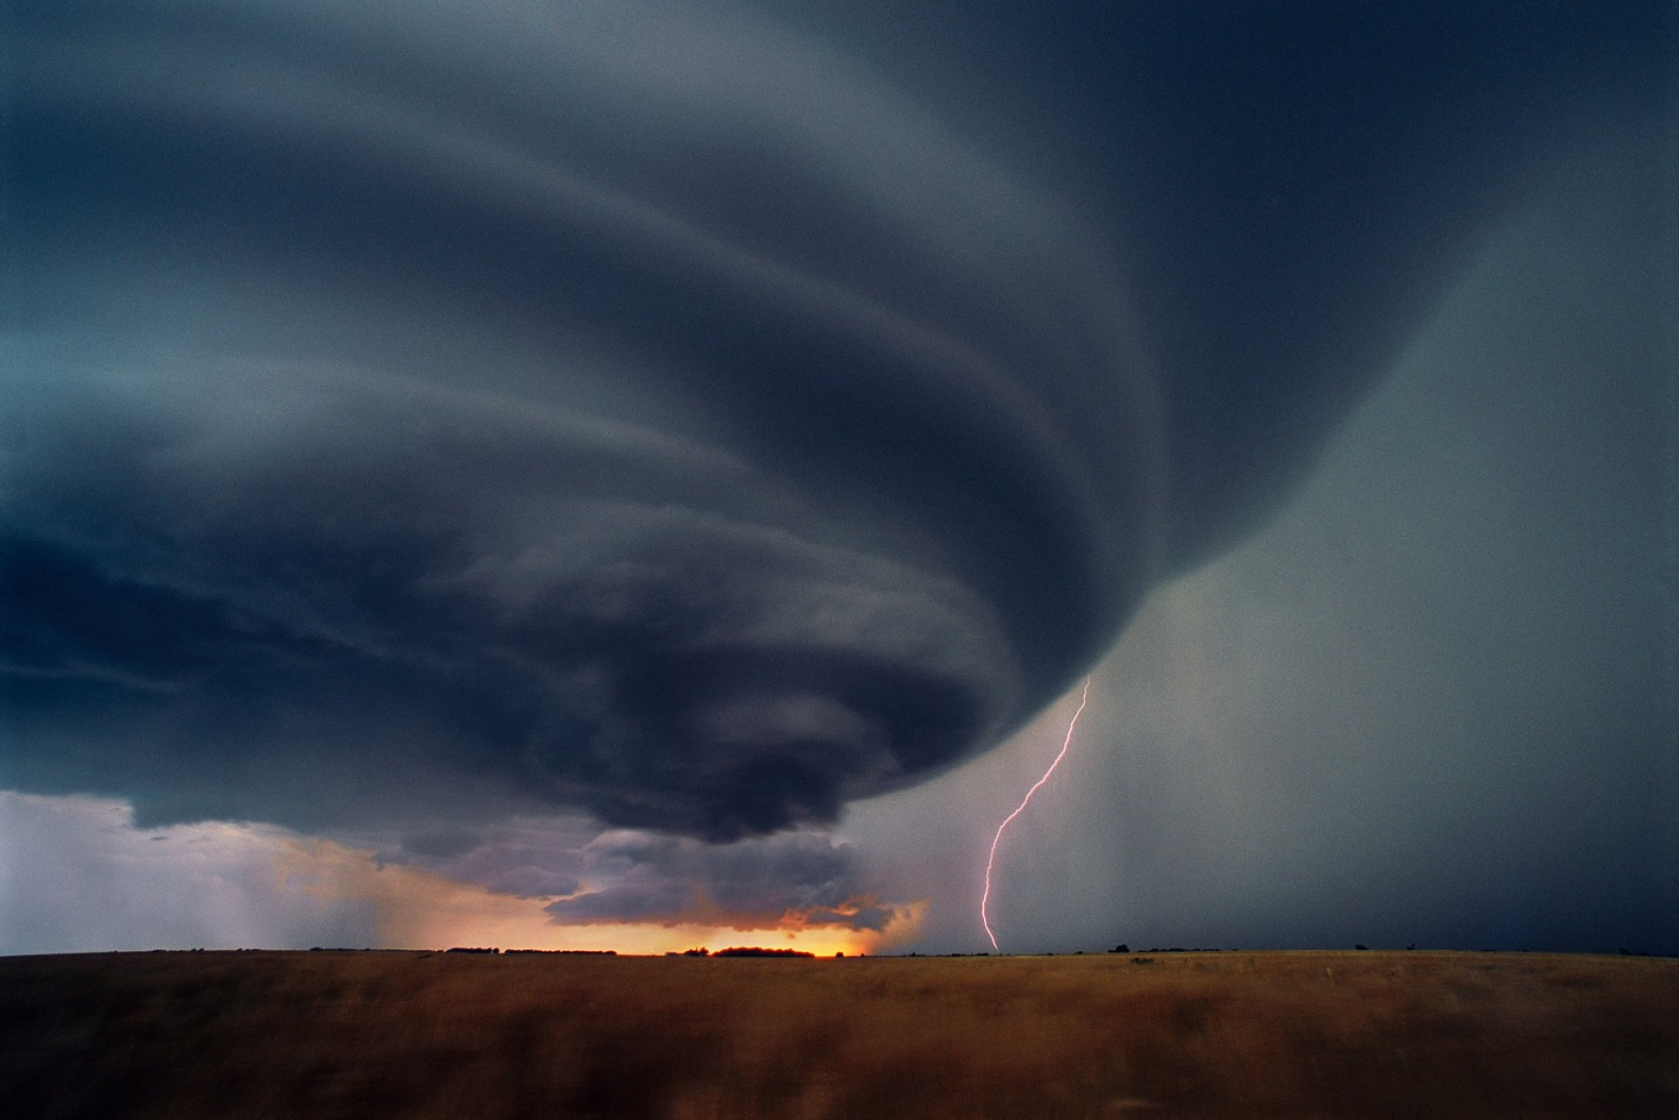

Slide 12
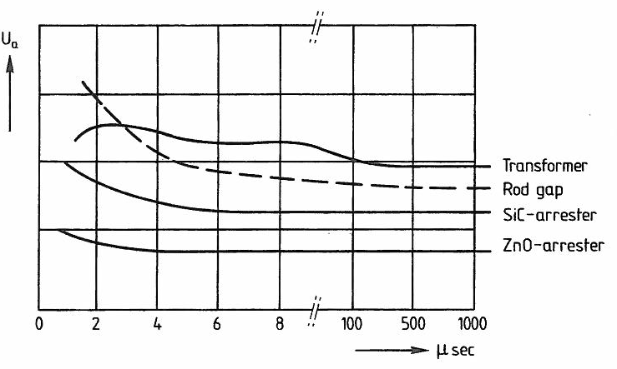
V-t curves for devices

Slide 13
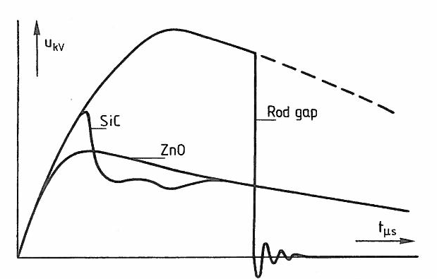
Diverting a lightning voltage wave by 3 different devices

